Slide 1
JVM Architecture

Slide 2
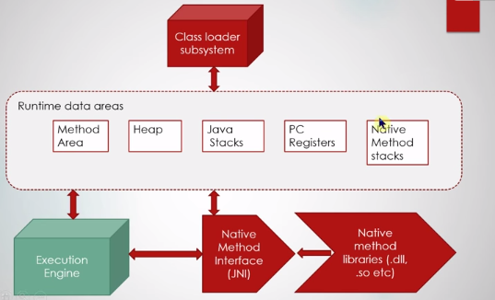
Architecture

Slide 3
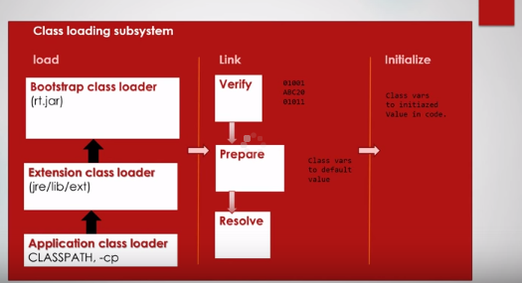
Class loader subsystem

Slide 4
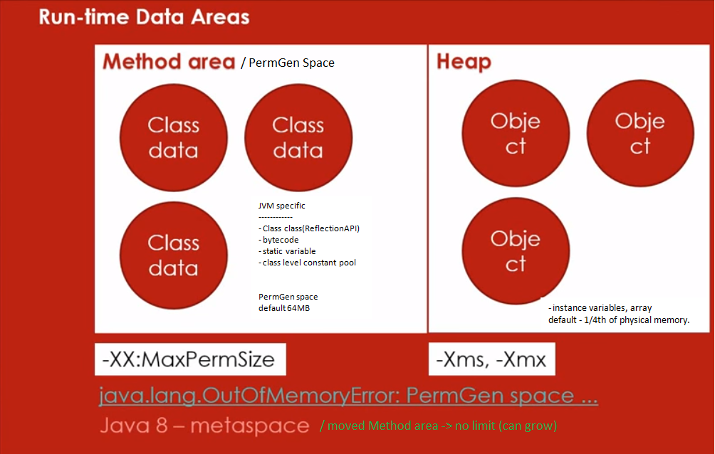
Run-Time Data Areas

Slide 5
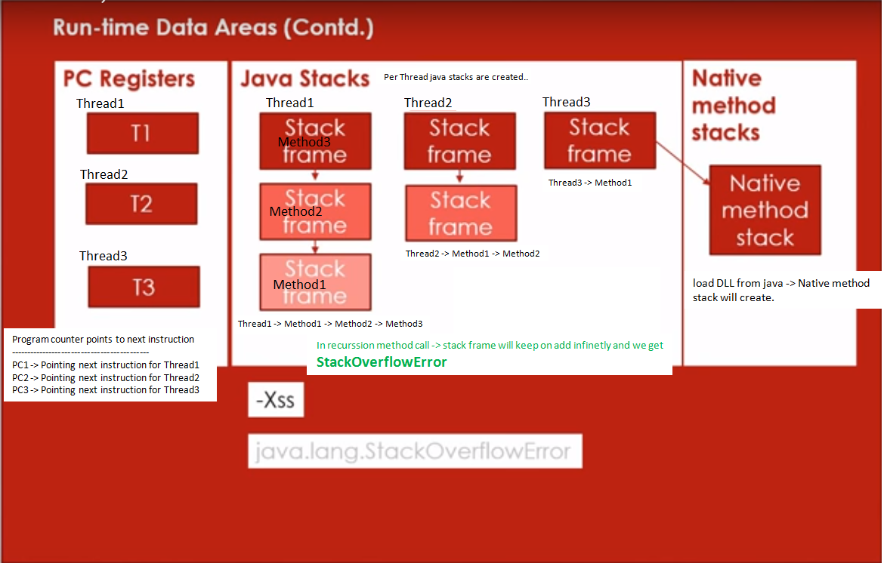
Run-Time Data Areas (..contd)

Slide 6
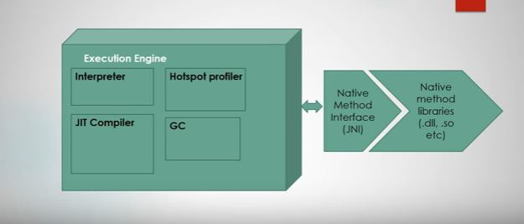
Execution Engine

